Slide 1
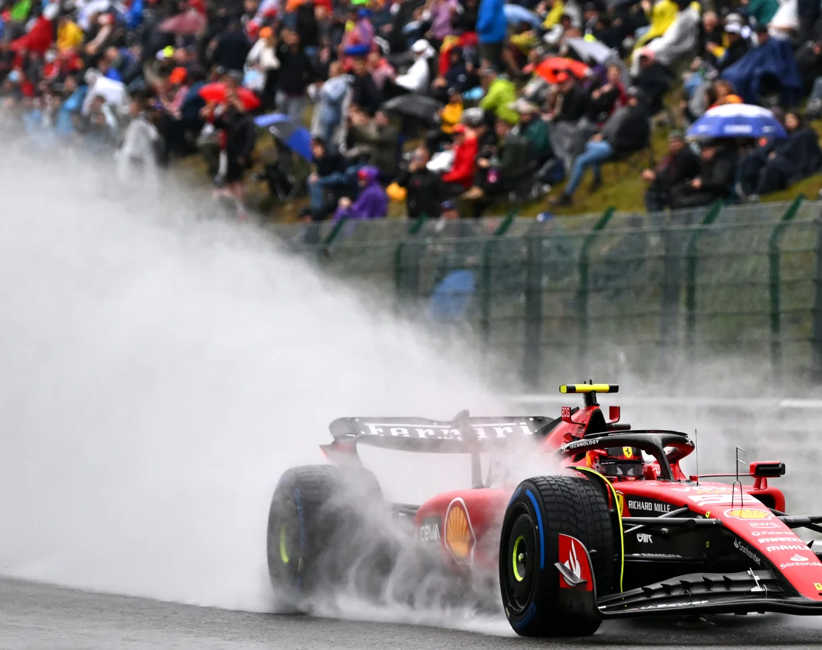
How Formula One Utilises Aerodynamics

